Slide 1
Solution Center Project Snapshot
These Slides Are Intended for Reuse
These slides are copyrighted using a Creative Commons license to allow and encourage campus stakeholders to use them (with attribution as described below) to advance their own renewable energy efforts. There are one- and five-page versions of the Project Snapshot in order to ease integration of this content into other campus slide decks as needed.
Copyright © 2020 https://creativecommons.org/licenses/by-sa/4.0/
This work is licensed under a Creative Commons Attribution-ShareAlike 4.0 International License by:
Second Nature Inc. https://secondnature.org/solutions-center/
License Overview
Share — copy and redistribute the material in any medium or format
Adapt — remix, transform, and build upon the material for any purpose, even commercially.
You must give appropriate credit. Adaptations must also use the same license.
Attribution Example
For an attribution example, see https://secondnature.org/solutions-center-content-license-and-attribution-guidelines/

Slide 2
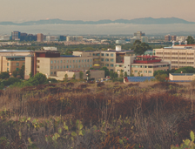

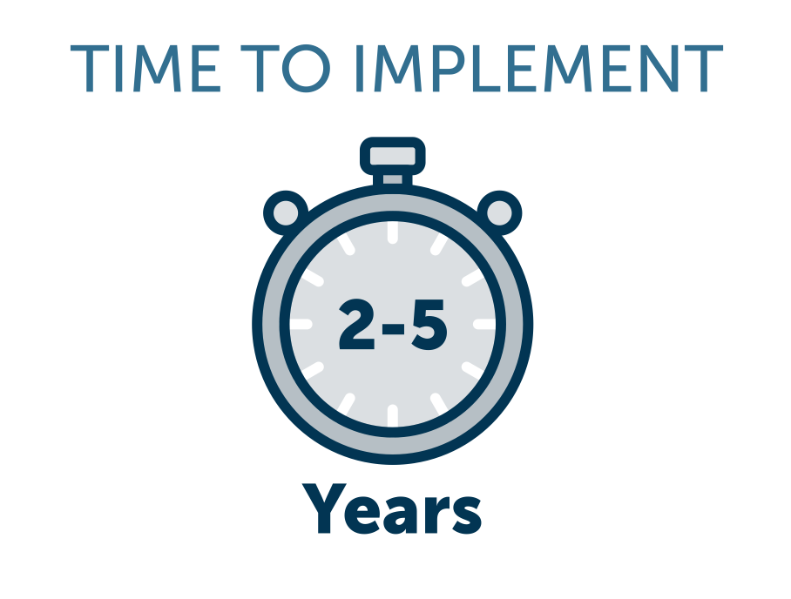
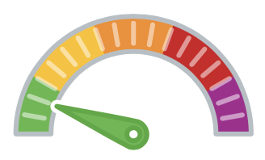




University of California Irvine’s Integrated Smart Labs Program
Laboratories, which can account for up to 70% of a campus's total energy consumption, are a focal area for carbon and energy management improvements on university campuses. The entire internal air volume of a typical lab building is released to the atmosphere via exhaust stacks every 5-8 minutes. An enormous amount of energy is required to supply, heat, cool, humidify, dehumidify, filter, distribute, and exhaust this air, and this process takes place 24/7, whether the laboratory is fully occupied, partially occupied, or vacant. In response, the University of California Irvine retrofitted their laboratories with smart technology to attain the following energy saving criteria:
Real-time air quality sensing that adjusts air-changes per hour (ACH) in response to certain contaminants
Reduced fan, filtration, and duct airspeeds below prior best practice standards
50-70% less exhaust fan energy by reducing stack discharge airspeeds
Reduced internal heat load to enable lower ACH feasibility (e.g., low illumination power density, daylighting sensors, Energy Star equipment, and exhaust grilles directly above heat-discharging equipment)
reduced thermal inputs during setback periods
Chemical hygiene safety assessments in laboratories
Preventative maintenance program for Smart Lab HVAC components/systems
GHG & Environmental Impact
Project Timeline
2-5 Years
Project Feasibility
Very Achievable
Large
Economic Impact & Savings
Net Savings
Project Maintenance
High
Publicity Impact
That’s
Pretty Cool

Slide 3
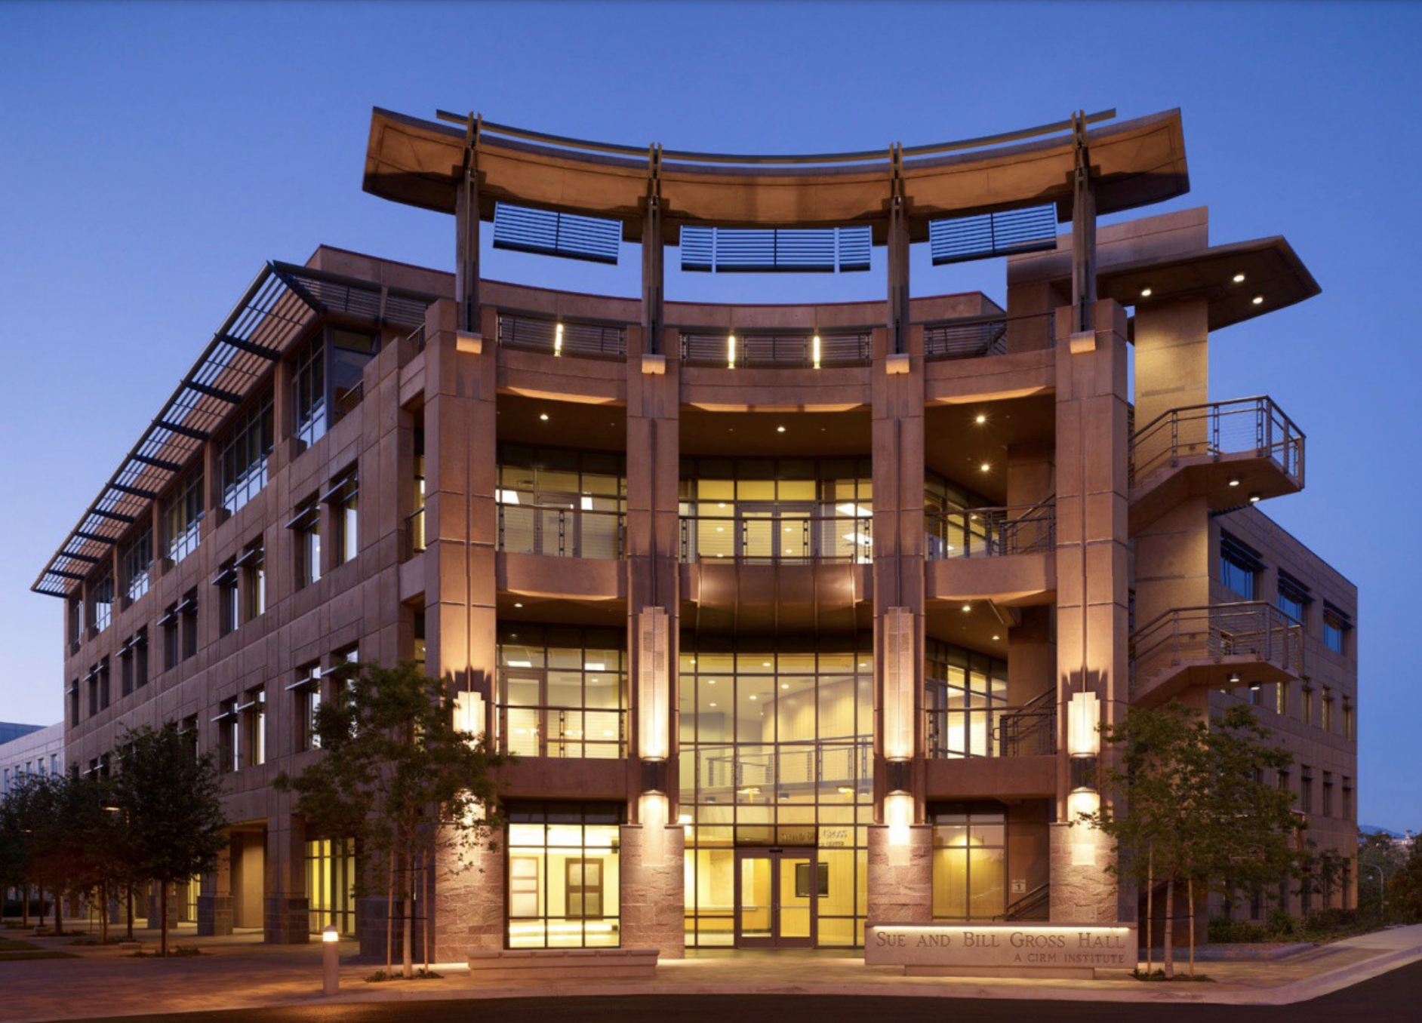
University of California Irvine’s Integrated Smart Labs Program

Slide 4
PROJECT
OVERVIEW
The University of California Irvine’s integrated Smart Labs program cut energy consumption by 50 percent, saving the university over 1.25 million dollars annually. The project was made possible by UCI and it’s committed to implementing climate action plans as a leading member of Second Nature’s Climate Leadership Network, as well as the California Inter-University Energy and Safety Coalition whose goal is to, “Create safer, more sustainable laboratories, balancing the need to meet the challenges of creating safe laboratory workspaces with the challenges to save energy and protect the environment.” It was also made possible by the Better Buildings Challenge, an initiative through the U.S. Department of Energy launched by Barack Obama in 2011 that set a goal of making American commercial and industrial buildings 20 percent more energy efficient by 2020.

Slide 5
PROJECT
IMPACT
GHG & Environmental Impact
Large
UCI through their Smart Labs initiative has reduced their Greenhouse Gas emissions by approximately 773,530 pounds of carbon dioxide per year.
Economic Impact & Savings
Net Savings
While the capital investment for a Smart Labs retrofit is sizable (since building controls and many features of ventilation, exhaust, and lighting systems get essentially re-engineered), the energy savings are substantial, saving about $1.25 million each year.

Slide 6
PROJECT
IMPACT
Project Feasibility
Very
Achievable
Retrofitting laboratories can be costly but will pay for themselves in energy savings. Prior to installing and activating reduced air-changes, a laboratory undergoes an assessment by an industrial hygiene/lab safety specialist. And not all laboratories require retrofitting; at UCI approximately 15 percent of laboratories were exempt from retrofitting.
Project Timeline
2-5 Years
The Smart Labs project is an ongoing paradigm to manage energy with no real end date. Requirements in the process set up include applying sensors and software, with real-time air quality sensing and system fault-detection, to deliver the right amount of ventilation and exhaust energy (and other energy forms necessary in a laboratory) at just the right place, at just the right time.

Slide 7
PROJECT
IMPACT
Project Maintenance
High
Required maintenance includes recalibrating the Aircuity sensors every six months as well as general monitoring/evaluation, changes in management and risk assessment for lab environment and ECDs (Exposure Control Devices).
Publicity Impact
That’s Pretty Cool!
UCI’s Smart Labs program saw an incredible increase in efficiency as laboratory buildings on a research university consume typically 60-70 percent of a campus’ total energy. UCI was invited to join President Obama’s Better Buildings Challenge to achieve an overall improvement of 20% for the campus by 2020. UC Irvine achieved the goal by 2013, attracting the attention of the EPA and DOE, as well as the direct praise from President Obama. The Smart Labs program has been adopted by seven United States National Laboratories and numerous U.S. research universities, as well as universities and a few firms in China and the U.K.

Slide 8
PROJECT
RESOURCES
UCI Smart Lab Resources
Better Buildings Challenge
Smart Laboratories Cut Energy Consumption More Than Half Better Buildings Challenge Demonstration Project (August 2013)
Smart Labs - A Success Story featuring Wendell Brase (8:39 minutes)

