Slide 1

Solution Center Project Snapshot
These Slides Are Intended for Reuse
These slides are copyrighted using a Creative Commons license to allow and encourage campus stakeholders to use them (with attribution as described below) to advance their own renewable energy efforts. There are one- and five-page versions of the Project Snapshot in order to ease integration of this content into other campus slide decks as needed.
Copyright © 2020 https://creativecommons.org/licenses/by-sa/4.0/
This work is licensed under a Creative Commons Attribution-ShareAlike 4.0 International License by:
Second Nature Inc. https://secondnature.org/solutions-center/
Coho Climate Advisors, LLC https://www.cohoclimate.com/
License Overview
Share — copy and redistribute the material in any medium or format
Adapt — remix, transform, and build upon the material for any purpose, even commercially.
You must give appropriate credit. Adaptations must also use the same license.
Attribution Example
”Michigan State University Solar PPA -- Solution Center Project Snapshot" by Second Nature, Inc. and Coho Climate Advisors, is licensed under CC BY-SA 4.0. See: https://creativecommons.org/use-remix/attribution/

Slide 2
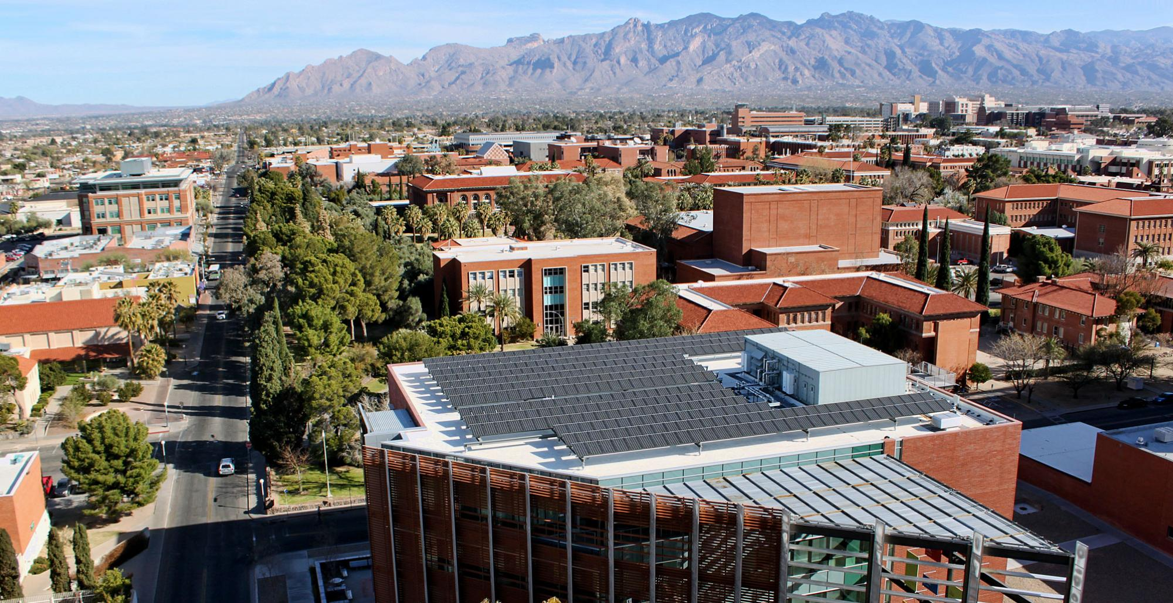



The University of Arizona’s Utility Renewable Energy Agreement
The University of Arizona uses as much power as 22,000 average American homes. The University sought to source renewable energy to eliminate 100% of the greenhouse gas emissions, (i.e. scope two) ~ 65,000 MTCO2e per year, associated with this electricity usage.
The University engaged CustomerFirst Renewables (CFR), an independent energy advisory firm, to guide the development and implementation of its renewable energy strategy. The result is a 20-year agreement with Tucson Electric Power (TEP) that will provide the university with 100% renewable electricity beginning in Spring 2021. Under the agreement, TEP will supply up to 26 megawatts (MW) of power from portions of two new projects. Half of the power will come from a 100 MW solar and storage facility at the Wilmot Energy Center in southeast Tucson, and the other half will come from the 250 MW Oso Grande Wind Project in southeastern New Mexico.
The agreement is the largest utility bilateral renewable energy agreement in the US between a university and a regulated utility and is expected to provide the University with significant savings compared to business-as-usual projections.
GHG & Environmental Impact
Enormous
Eliminate 65k MTCO2e annually
Project Timeline
1-2 Years
Project Feasibility
Difficult
Economic Impact & Savings
Large Net Savings
Project Maintenance
Low/None
Publicity Impact
Wow,
amazing project

Slide 3
The University of Arizona’s Utility Renewable Energy Agreement

Slide 4

PROJECT
OVERVIEW
The University of Arizona, advised by CustomerFirst Renewables, entered a 20-year agreement with Tucson Electric Power to provide 100% renewable electricity beginning in Spring 2021. The electricity will avoid 65,000 MTCO2e annually, and is supplied by the 250 MW Oso Grande Wind Project in southeastern New Mexico, and the 100 MW Wilmot Energy Center, a solar project in southeast Tucson which also includes energy storage. This is the largest utility bilateral renewable energy agreement in the US between a university and a regulated utility and is expected to provide the University with significant savings compared to business-as-usual projections.
GHG & Environmental Impact
Enormous
Eliminate 65k MTCO2e annually
Project Timeline
1-2 Years
Project Feasibility
Difficult
Economic Impact & Savings
Large Net Savings
Project Maintenance
Low/None
Publicity Impact
Wow,
amazing project

Slide 5
PROJECT
IMPACT
GHG & Environmental Impact
Enormous
Eliminate 65k MTCO2e annually
As the largest campus/utility bilateral agreement in North America, this project will slash the University’s total greenhouse gas footprint by nearly one-third by eliminating the entirety of its Scope 2 emissions, approximately 65,000 MTCO2e per year.
Economic Impact & Savings
Large Net Savings
The University of Arizona will pay TEP a fixed green energy charge that is anticipated to result in significant savings and improved budget certainty over the course of the 20-year contract. The majority of these savings are expected to result from forecasted increases in the University’s electricity rates over the same 20-year period.

Slide 6

PROJECT
IMPACT
Project Feasibility
Difficult
The University’s culture of shared governance required the participation of numerous stakeholders on campus, including the University’s Faculty Senate, Academic Dean’s Council, and others. This project also required intensive education for the majority of those on the “core team,” which included representatives from the University’s Office of Sustainability, Planning, Design, & Construction department, Facilities Management department, and Office of General Counsel. Numerous conversations were also had with the University’s Chief Financial Officer and President.
After the agreement was signed, it ultimately required approval by the Arizona Corporation Commission (ACC), the state’s utilities regulator. This required additional coordination between TEP and the University’s Marketing & Communications department.
Project Timeline
1-2 Years
The time from renewable energy planning to the commercial operation dates (CODs) of the projects was just under three years. The University spent about eight months with CFR conducting internal education, comparing renewables solutions (e.g. virtual power purchase agreements [VPPAs], utility-bilaterals, and onsite solar array sites), developing its renewable energy strategy, and issuing an RFP to compare VPPAs with an offer from TEP. While there were attractive VPPAs available, the University decided to pursue an agreement with TEP that would provide more budget certainty, while supporting the development of in-state renewable energy projects. Eight months were required to negotiate the agreement with TEP, and an additional four months for approval by the ACC. Both projects were planned for COD approximately one year later.

Slide 7

PROJECT
IMPACT
Project Maintenance
Low/None
The University does not own either project (it purchases the electricity they produce) and therefore bears no responsibility for project operations or maintenance.
Publicity Impact
Wow,
amazing project
In addition to the procurement of large-scale renewable energy for the University’s main campus, the agreement also committed both parties to the development of two on-campus solar demonstration projects. These projects will help to anchor the off-site agreement to campus in a highly visible manner, enabling campus and community members alike to understand the full scope of the agreement, while also allowing for novel research and teaching opportunities.
Both projects will be fitted with physical and online dashboards that will display the real-time generation of energy from the projects themselves, as well as the energy from the two off-campus facilities powering the majority of campus. With the inclusion of these projects, the University of Arizona is fulfilling its mission of institutional excellence and meeting its operational needs in ways that support both its teaching, research and environmental sustainability goals.

