Slide 1

Solution Center Project Snapshot
These Slides Are Intended for Reuse
These slides are copyrighted using a Creative Commons license to allow and encourage campus stakeholders to use them (with attribution as described below) to advance their own renewable energy efforts. There are one- and five-page versions of the Project Snapshot in order to ease integration of this content into other campus slide decks as needed.
Copyright © 2020 https://creativecommons.org/licenses/by-sa/4.0/
This work is licensed under a Creative Commons Attribution-ShareAlike 4.0 International License by:
Second Nature Inc. https://secondnature.org/solutions-center/
Coho Climate Advisors, LLC https://www.cohoclimate.com/
License Overview
Share — copy and redistribute the material in any medium or format
Adapt — remix, transform, and build upon the material for any purpose, even commercially.
You must give appropriate credit. Adaptations must also use the same license.
Attribution Example
”Michigan State University Solar PPA -- Solution Center Project Snapshot" by Second Nature, Inc. and Coho Climate Advisors, is licensed under CC BY-SA 4.0. See: https://creativecommons.org/use-remix/attribution/

Slide 2
PROJECT SNAPSHOT
VERSION #1
ONE-PAGE PROJECT
SUMMARY

Slide 3
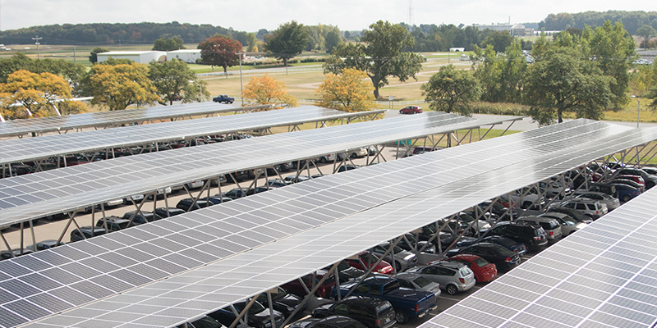
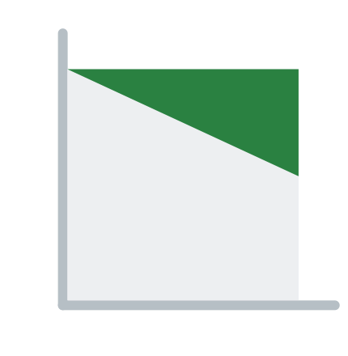



Michigan State University
Solar Carport Power Purchase Agreement
MSU constructed a 10.5 MW solar carport on five large commuter parking lots covering about 5,000 parking spaces. The nearly 40,000 panel system will accumulate energy from the sun while protecting cars from heat, rain, and snow.
The project was structured using a 25-year power purchase agreement with Inovateus Solar and Alterra Power, facilitated by CustomerFirst Renewables. Under the agreement, Inovateus and Alterra financed the construction of the facility and MSU will buy the electricity produced by the solar array. As a result, MSU expects to realize about $10 million in electricity cost savings over the project lifetime.
Construction started in March 2017 and was completed in December 2017. Since then, the project has received widespread recognition due to being the largest solar carport in North America.
GHG & Environmental Impact
Moderate
Project Timeline
1-2 Years
Project Feasibility
Some Challenges
Economic Impact & Savings
Net Savings
Project Maintenance
Low/None
Publicity Impact
Wow,
amazing project

Slide 4
PROJECT SNAPSHOT
VERSION #2
FIVE-PAGE DETAILED
PROJECT OVERVIEW

Slide 5

Michigan State University
Solar Carport PPA

Slide 6
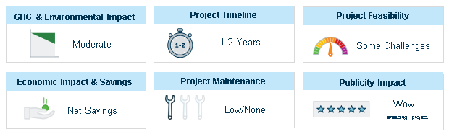
PROJECT
OVERVIEW
Michigan State University (MSU), assisted by CustomerFirst Renewables (CFR), competitively sourced proposals to cover major parking areas on campus with solar carports. As a result, MSU entered into a 25-year Power Purchase Agreement (PPA) with Inovateus Solar and Alterra Power.
Inovateus and Alterra constructed arrays on five large commuter parking lots covering a total of ~5,000 parking spaces. 39,960 solar panels will produce about 15,000 MWh/year, providing ~5 percent of the university’s electricity. The project provides 14% of MSU’s electric power consumption.
In addition to providing renewable power, the project offers engineering students the opportunity to study various solar technologies and their integration into a micro-grid.

Slide 7
PROJECT
IMPACT
GHG & Environmental Impact
Moderate
Economic Impact & Savings
Net Savings
The solar carports are designed to deliver a peak power of 10.5 MW and generate 15 million KWh per year, which is enough to power approximately 1,800 Michigan homes.
Buying electricity from these carport solar arrays is expected to save MSU about $10 million in electricity costs over the 25-year project lifetime.

Slide 8
PROJECT
IMPACT
Project Feasibility
Some Challenges
Project Timeline
1-2 Year
While the innovative design of the solar carport conserves space and resources, research was required to meet structure and state height requirements, understand local tax incentives and safety considerations, allow for snow and ice removal, and account for wind load, water control, and erosion impacts. Additionally, construction had to adhere to a strict schedule to minimize disruption to parking lot users.
Supported by CFR, MSU issued a competitive request for proposals (RFP) to solar developers, conducted a selection process, and shaped the project development process. Construction began in March 2017 and the project commenced operations in December 2017.

Slide 9

PROJECT
IMPACT
Project Maintenance
Low/None
Publicity Impact
Wow,
amazing project
While MSU provides the physical site for the project, it was built and is owned and operated by a third party. Through the PPA, MSU is responsible for purchasing the electricity generated by the arrays, whereas the project owner is responsible for all operations and maintenance.
Since construction, MSU’s project has received national recognition as the largest carport solar array in North America. In 2018, the project received an Innovative Project Award from the U.S. Green Building Council of West Michigan. The carports also provide engineering students and faculty with teaching and research opportunities, as well as weather protection for tailgaters during MSU football games.

