Slide 1

Solution Center Project Snapshot
These Slides Are Intended for Reuse
These slides are copyrighted using a Creative Commons license to allow and encourage campus stakeholders to use them (with attribution as described below) to advance their own renewable energy efforts. There are one- and five-page versions of the Project Snapshot in order to ease integration of this content into other campus slide decks as needed.
Copyright © 2020 https://creativecommons.org/licenses/by-sa/4.0/
This work is licensed under a Creative Commons Attribution-ShareAlike 4.0 International License by:
Second Nature Inc. https://secondnature.org/solutions-center/
Coho Climate Advisors, LLC https://www.cohoclimate.com/
License Overview
Share — copy and redistribute the material in any medium or format
Adapt — remix, transform, and build upon the material for any purpose, even commercially.
You must give appropriate credit. Adaptations must also use the same license.
Attribution Example
”Michigan State University Solar PPA -- Solution Center Project Snapshot" by Second Nature, Inc. and Coho Climate Advisors, is licensed under CC BY-SA 4.0. See: https://creativecommons.org/use-remix/attribution/

Slide 2
PROJECT SNAPSHOT
VERSION #1
ONE-PAGE PROJECT
SUMMARY

Slide 3

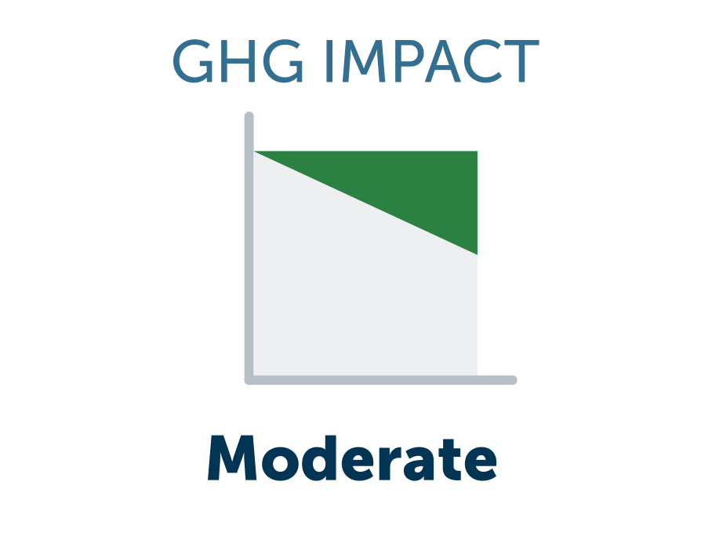
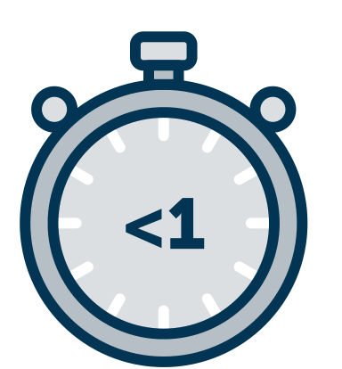
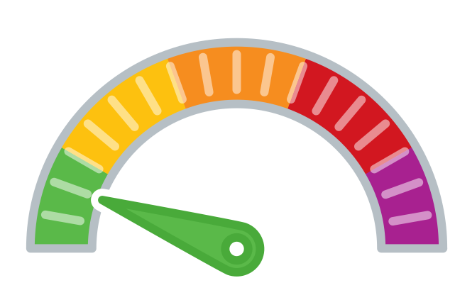

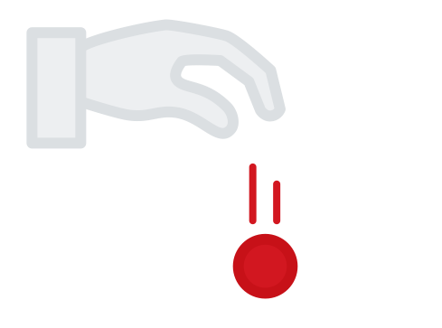

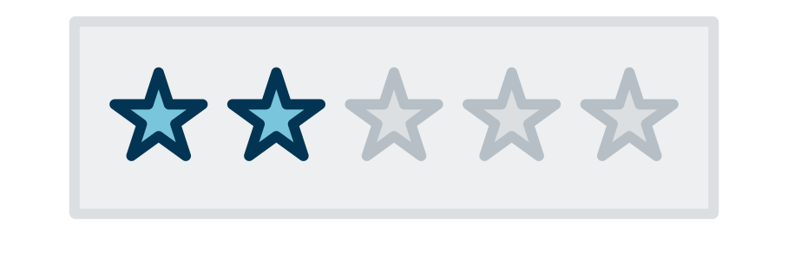
Loyola’s Renewable Energy Credit (REC) Strategy
Loyola University Chicago began purchasing unbundled RECs in 2008, driven by a desire to meet LEED requirements. Student pressure led Loyola to increase its purchase of RECs to 35% (equivalent to the residence hall usage) and then to 50% with increased budget support. Loyola plans to continue buying unbundled RECs as a short-term strategy through 2022 until, with support from CustomerFirst Renewables, it executes a long-term renewable energy contract for 100% of its electricity, causing a new renewable energy project to be added to the grid.
GHG & Environmental Impact
Moderate
Project Timeline
<1 Years
Project Feasibility
Very Achievable
Economic Impact & Savings
Small Net Cost
Project Maintenance
Low/None
Publicity Impact
That’s Interesting

Slide 4
PROJECT SNAPSHOT
VERSION #2
FIVE-PAGE DETAILED
PROJECT OVERVIEW

Slide 5
Loyola’s Renewable Energy Credit (REC) Strategy

Slide 6
PROJECT
OVERVIEW
Loyola University Chicago began purchasing “unbundled” RECs (i.e. RECs sold separately from the energy that produced them) in 2008, driven by a desire to meet LEED requirements. In 2015, the University created a climate action plan targeting carbon neutrality for scopes 1 & 2 by 2025. These goals, in combination with student pressure and increased funding, led Loyola to increase its purchase of RECs to 35% of its annual load in 2018. In 2019, Loyola partnered with CustomerFirst Renewables to explore ways to replace its short-term unbundled REC strategy with a long-term renewable energy contract. In 2023, the University expects to be supplied by a new renewable energy project added to the grid.
GHG & Environmental Impact
Moderate
Project Timeline
<1 Year
Project Feasibility
Very Achievable
Economic Impact & Savings
Small Net Cost
Project Maintenance
Low/None
Publicity Impact
That’s Interesting

Slide 7
PROJECT
IMPACT
GHG & Environmental Impact
Moderate
Economic Impact & Savings
Small Net Cost
Loyola initially purchased RECs in 2008 to earn LEED certification for a single facility. Today, Loyola purchases unbundled RECs that account for 100% of their load. This contributes to Loyola’s 2025 carbon neutrality goals.
One difference between unbundled RECs and RECs bundled in an energy supply contract is that unbundled RECs are sourced from projects that have been in operation for up to 15 years, whereas RECs sourced with energy contracts typically come from projects that are net-new to the grid at the time the contract is executed.
The scale of GHG impact depends on the volume of RECs purchased as well as the carbon-intensity of the grid where the project is located that generated the RECs.
Unbundled RECs are low-cost compared to self-financing a renewable energy project. However, REC prices vary widely from market to market and change over time due to market dynamics, and policy and regulatory regimes both nationally and locally. Between 2008 (when Loyola first bought RECs) and 2021, Loyola’s RECs have ranged in price from ~$1.60 to $6 per REC, with annual costs of as little as ~$7,000 (for one building) to ~$100,000 (for 100% of their annual load).

Slide 8
PROJECT
IMPACT
Project Feasibility
Very Achievable
Project Timeline
<1 Year
Purchasing unbundled RECs can be as simple as contacting an energy or REC broker and requesting a price and making the purchase.
Historically, Loyola has purchased unbundled RECs on an annual basis. When the University implements a long-term renewable energy contract (expected in 2022) it will lock in RECs for the duration of the multi-year contract.

Slide 9

PROJECT
IMPACT
Project Maintenance
Low/None
Publicity Impact
That’s
Interesting
Procurement activity is incurred every time a new REC contract is required, typically on an annual basis. However, since REC procurements are contractual, not physical, they do not require any facilities maintenance.
Buying unbundled RECs for 100% of its annual purchased electricity allows Loyola to claim neutrality for scope 2 GHG emissions. However, unbundled RECs can be difficult to describe to the general public, and their value as a renewable energy strategy is debated by some buyers and advocacy organizations.
Notes:
Banner for student success pushing for RECs

Slide 10
WHAT’S NEXT: LOYOLA’S
RETAIL CONTRACT
Since Loyola’s initial purchase of unbundled RECs, the University has developed a climate action plan outlining multiple emission reduction targets, including neutrality for scopes 1 & 2 by 2025.
These ambitious goals, along with stakeholder input, motivated the University to pursue 100% renewable energy. With an increasingly complex renewable energy marketplace, Loyola enlisted CustomerFirst Renewables to investigate new ways to purchase renewable energy. As a result, Loyola explored two ways to purchase large-scale renewable energy, via a “structured” retail contract and via a wholesale power purchase agreement, a.k.a. virtual PPA.
Comparing these options, Loyola determined the best fit was a retail delivery agreement based on a sleeved PPA. In this arrangement, the retail provider executes a PPA with a project selected by Loyola, swaps high-cost compliance RECs from the project for lower-cost voluntary RECs. The contract is expected to provide Loyola with significant cost savings, integrated monthly billing, and carbon-neutrality for scope 2 emissions.

