Slide 1

Solution Center Project Snapshot
These Slides Are Intended for Reuse
These slides are copyrighted using a Creative Commons license to allow and encourage campus stakeholders to use them (with attribution as described below) to advance their own renewable energy efforts. There are one- and five-page versions of the Project Snapshot in order to ease integration of this content into other campus slide decks as needed.
Copyright © 2020 https://creativecommons.org/licenses/by-sa/4.0/
This work is licensed under a Creative Commons Attribution-ShareAlike 4.0 International License by:
Second Nature Inc. https://secondnature.org/solutions-center/
Coho Climate Advisors, LLC https://www.cohoclimate.com/
License Overview
Share — copy and redistribute the material in any medium or format
Adapt — remix, transform, and build upon the material for any purpose, even commercially.
You must give appropriate credit. Adaptations must also use the same license.
Attribution Example
”Michigan State University Solar PPA -- Solution Center Project Snapshot" by Second Nature, Inc. and Coho Climate Advisors, is licensed under CC BY-SA 4.0. See: https://creativecommons.org/use-remix/attribution/

Slide 2
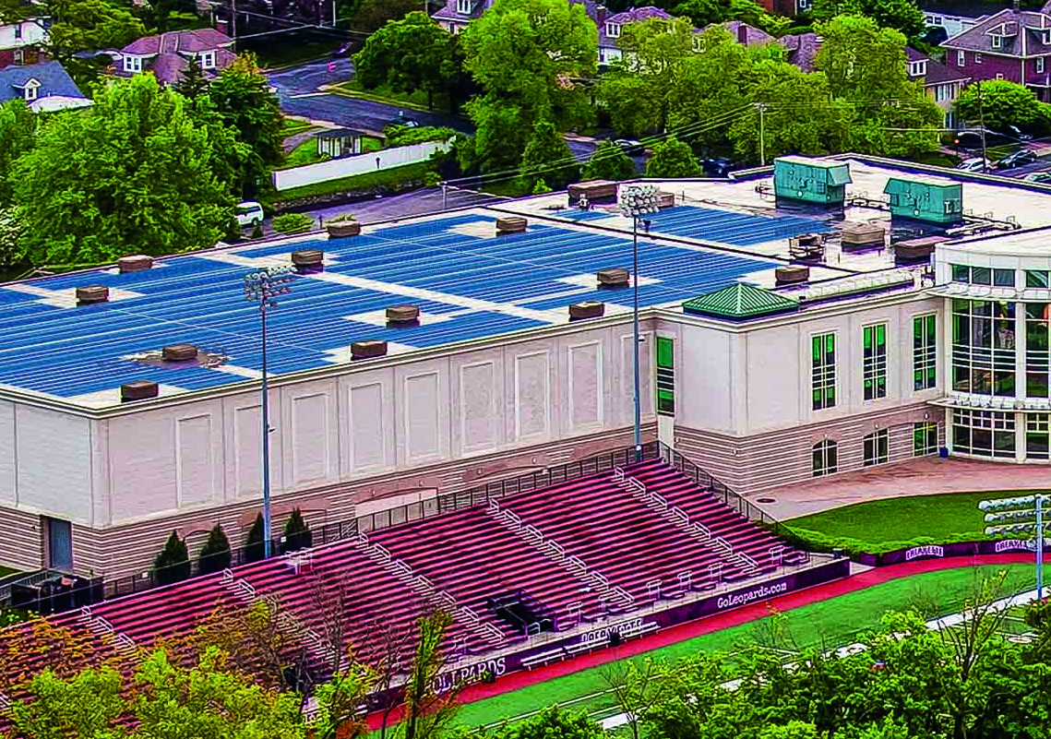

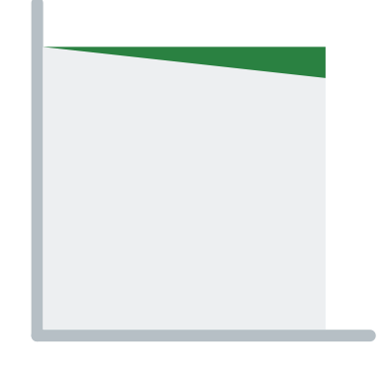
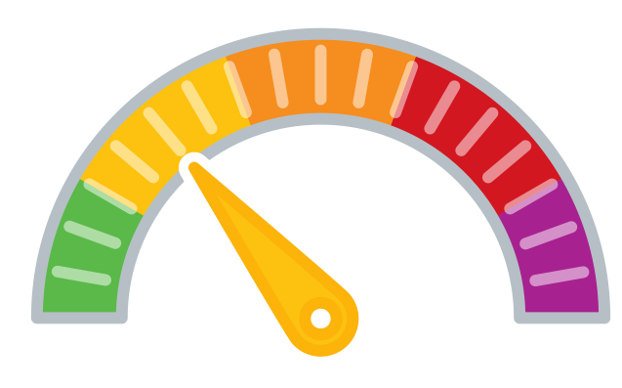
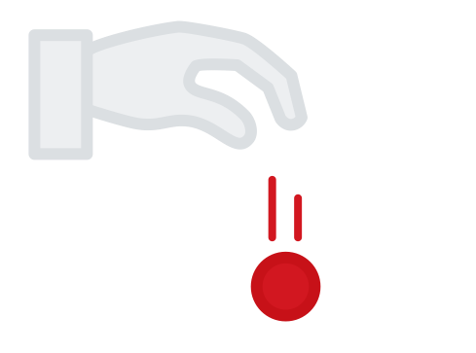

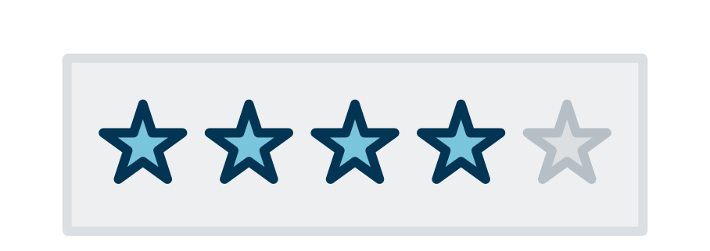
Lafayette’s Onsite Solar Power Purchase Agreement (PPA)
An approximately 470-kilowatt (kW) solar array will power operations at the Kirby Sports Center on Lafayette’s campus. The solar installation is expected to generate around 540 megawatt-hours (MWh) of clean, renewable energy annually and array and will offset 9,625 metric tons of carbon dioxide (CO2) over its 25-year lifetime. The project provides a visual representation of Lafayette’s commitment to carbon neutrality as well as numerous educational opportunities.
The College engaged CustomerFirst Renewables for preliminary development and contracted with Pfister Energy, a commercial solar developer and EPC, and Greenskies Clean Energy, a leader in commercial renewable energy solutions. Pfister Energy will be responsible for engineering and construction, and Greenskies will finance and manage the solar operations. Together, Greenskies and Pfister Energy are providing internship positions to Lafayette students for a five-year duration.
GHG & Environmental Impact
Miniscule
Eliminate 9,625 MTCO2e
Project Timeline
1-2 Years
Project Feasibility
Doable
Economic Impact & Savings
Small Net Cost
Project Maintenance
Low/None
Publicity Impact
That’s Really Cool

Slide 3
Lafayette’s Onsite Solar Power Purchase Agreement

Slide 4
PROJECT
OVERVIEW
Lafayette College, advised by CustomerFirst Renewables, entered into an agreement with Pfister Energy and Greenskies Clean Energy to construct a rooftop solar array on Lafayette’s sports center and provide 540 megawatt-hours (MWh) of renewable energy annually. The electricity will avoid 9,625 MTCO2 over its 25-year lifetime. The array is a highly visible representation of Lafayette’s commitment to carbon neutrality. Lafayette also receives access to numerous educational opportunities under the agreement such as live and historical production data, detailed design drawings, construction footage, tours of the facility, guest lectures, and paid internships.
GHG & Environmental Impact
Miniscule
Eliminate 9,625 MTCO2e
Project Timeline
1-2 Years
Project Feasibility
Doable
Economic Impact & Savings
Small Net Cost
Project Maintenance
Low/None
Publicity Impact
That’s Really Cool

Slide 5
PROJECT
IMPACT
GHG & Environmental Impact
Miniscule
Eliminate 9,625 MTCO2e
over its lifetime
Economic Impact & Savings
Small Net Cost
Rooftop solar arrays are constrained by site conditions, such as roof space, roof condition, shading, and other factors.
At 470 kW, this array generates a small percentage of Lafayette’s electricity, and avoids a small amount of GHGs, making a minor contribution to their goal of carbon-neutrality by 2035.
Due to the relatively high value of PA RECs, Lafayette opted to substitute project RECs with national Green- certified RECs.
While this array entails a small net cost per kWh compared to brown power, it is part of a broader strategy that includes participation in a power purchase agreement aggregation with Lehigh University, Muhlenberg College, and Dickinson College (PHEC) that will enable all four institutions to mitigate 100% of their emissions associated with electricity consumption.

Slide 6
PROJECT
IMPACT
Project Feasibility
Doable
Project Timeline
1-2 Years
Feasibility is highly impacted by specific campus conditions and local electricity markets and regulations, but hundreds of campuses across the U.S. have installed onsite solar arrays. Rooftop arrays require permitting and interconnection approval, which is typically managed by the project owner or installer.
The procurement process included a request for proposal (RFP) from developers for bids, a selection process, and then a development period. The active construction is expected to take 3-6 months. Target commercial operation date is September 2021.

Slide 7

PROJECT
IMPACT
Project Maintenance
Low/None
Publicity Impact
That’s
Really Cool
As an onsite power purchase agreement, the project is owned by a third party responsible for all operations and maintenance. Lafayette has access to real time production and weather data to see how the system is preforming.
The array’s high visibility helps to engage and educate campus stakeholders about Lafayette’s broader sustainability efforts. Located on the roof of the Kirby Sports Center, the array is visible from the football field and a parking area. The project also includes paid internships, guest lectures, tours, and engineering curriculum. Lafayette was provided detailed design drawings, and construction footage provided insight into the PV system’s development process.​

