Slide 1

Solution Center Project Snapshot
These Slides Are Intended for Reuse
These slides are copyrighted using a Creative Commons license to allow and encourage campus stakeholders to use them (with attribution as described below) to advance their own renewable energy efforts. There are one- and five-page versions of the Project Snapshot in order to ease integration of this content into other campus slide decks as needed.
Copyright © 2020 https://creativecommons.org/licenses/by-sa/4.0/
This work is licensed under a Creative Commons Attribution-ShareAlike 4.0 International License by:
Second Nature Inc. https://secondnature.org/solutions-center/
Coho Climate Advisors, LLC https://www.cohoclimate.com/
License Overview
Share — copy and redistribute the material in any medium or format
Adapt — remix, transform, and build upon the material for any purpose, even commercially.
You must give appropriate credit. Adaptations must also use the same license.
Attribution Example
”Michigan State University Solar PPA -- Solution Center Project Snapshot" by Second Nature, Inc. and Coho Climate Advisors, is licensed under CC BY-SA 4.0. See: https://creativecommons.org/use-remix/attribution/

Slide 2
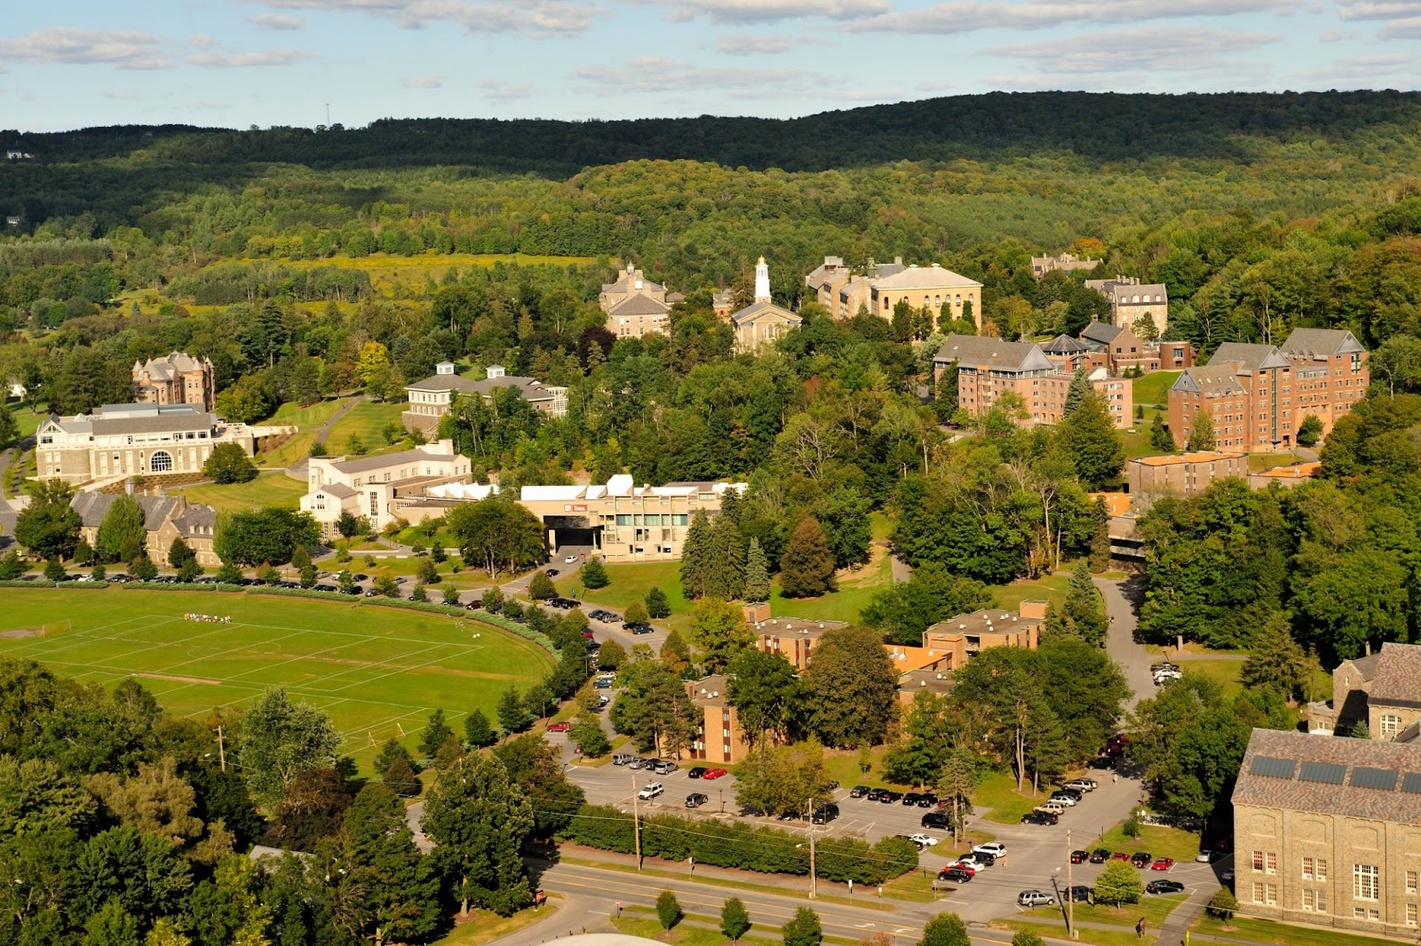


Colgate University Forest Carbon Inventory

Slide 3






Colgate University Forest Carbon Inventory
Colleges and universities across the United States and beyond own and manage significant landholdings. How this land is cared for and managed can either mitigate or contribute to climate change. Campus trees and forested land are especially important as trees/forests can sequester carbon from the atmosphere and store it for long periods of time. Alternatively, when trees are cut down or forests are converted then carbon can be released contributing to additional climate impacts. At Colgate, they support the argument that campus trees and forests should be an integral part of the broader campus carbon inventory.
Colgate University owns and manages over 1,059 acres of forested land. The long-term sustainable management of this forest plays an important role as a carbon sink and helps to counterbalance the university's greenhouse gas emissions through its operations, in addition to the many other public benefits and ecosystem services this land provides.
GHG & Environmental Impact
Moderate
Project Timeline
10+ years
Project Feasibility
Doable
Economic Impact & Savings
Net Savings
Project Maintenance
Moderate
Publicity Impact
That’s really cool

Slide 4

PROJECT
OVERVIEW
The baseline for Colgate's forest carbon inventory was established in 2013 when 174 permanent plots were established and field measurements were taken by the university's contracted forester in partnership with Colgate's Office of Sustainability. From these measurements, they were able to determine that Colgate's forests stored 165,491 tons of carbon.
Five years later, in 2018, each of the 174 plots were revisited and the tree measurements were retaken. Based on these measurements, it was determined that Colgate's forests stored 193,755 tons of carbon or 28,264 additional tons of carbon from the 2013 baseline. From these results, they were able to calculate that the annual rate of carbon sequestration in Colgate's forests were 3,776 tons per year. As long as the university continues to manage their forests well, then they will continue to help counterbalance their operational greenhouse gas emissions. However, Colgate also tracks carbon emissions from harvested wood based on the final product. For example, in 2017, Colgate removed 86 trees for the construction of new residence halls. This resulted in 91 tons of carbon being released into the atmosphere which added to Colgate's carbon footprint that year.
Importantly, the annual rate of sequestration of Colgate's forests will change over time as their forests age as well as changes in growing conditions and soil nutrients. For this reason, they will revisit their plots every five years for remeasurement and to adjust their values for stored forest carbon and annual rate of sequestration.
To complement this work, Colgate also has a forest stewardship management plan and in 2013 they received certification from the American Tree Farm System for long-term sustainable management.
GHG & Environmental Impact
Moderate
Project Timeline
10+ years
Project Feasibility
Doable
Economic Impact & Savings
Net Savings
Project Maintenance
Moderate
Publicity Impact
That’s really cool

Slide 5

PROJECT
IMPACT
GHG & Environmental Impact
Moderate
This project counterbalances the university’s gross emissions by about ⅓ and provides important educational and ecosystem service benefits.
Economic Impact & Savings
Net Savings
This project results in a moderate net savings as the university spends about $30K every five-years to re-inventory their forested lands. However, they save slightly more than this in avoided carbon offset purchases.

Slide 6
PROJECT
IMPACT
Project Feasibility
Doable
Project Timeline
10+ years
Once the baseline forest carbon inventory has been established, then remeasurement should reoccur on a 5-year interval.
Establishing a forest carbon baseline and field measurements are the most technical aspects of this project. Working with a trained forester can help work through these logistics. Also, software tools such as iTree can provide reasonable estimates without the time and expense of field measurements.
It is highly recommended to certify campus forests to help ensure that the forest is managed well and value is added.

Slide 7
PROJECT
IMPACT
Project Maintenance
Moderate
Creating and updating a forest management plan and doing the field work are essential components of this project. Depending on the size of the campus forest, this can take days to months to complete every 5 years.
Publicity Impact
That’s really
cool
This project has garnered a fair amount of interest from other institutions and sustainability practitioners. Over the years, Colgate has introduced this project at AASHE conferences and at Second Nature’s Climate Leadership Summit. This is in addition to working directly with other campuses who have modeled their project.
Most importantly, they have been able to emphasize the importance of land and forest stewardship in helping to solve two of the most pressing environmental challenges of our time: climate change and loss of biodiversity.

