Slide 1

Solution Center Project Snapshot
These Slides Are Intended for Reuse
These slides are copyrighted using a Creative Commons license to allow and encourage campus stakeholders to use them (with attribution as described below) to advance their own renewable energy efforts. There are one- and five-page versions of the Project Snapshot in order to ease integration of this content into other campus slide decks as needed.
Copyright © 2020 https://creativecommons.org/licenses/by-sa/4.0/
This work is licensed under a Creative Commons Attribution-ShareAlike 4.0 International License by:
Second Nature Inc. https://secondnature.org/solutions-center/
Coho Climate Advisors, LLC https://www.cohoclimate.com/
License Overview
Share — copy and redistribute the material in any medium or format
Adapt — remix, transform, and build upon the material for any purpose, even commercially.
You must give appropriate credit. Adaptations must also use the same license.
Attribution Example
”Michigan State University Solar PPA -- Solution Center Project Snapshot" by Second Nature, Inc. and Coho Climate Advisors, is licensed under CC BY-SA 4.0. See: https://creativecommons.org/use-remix/attribution/

Slide 2
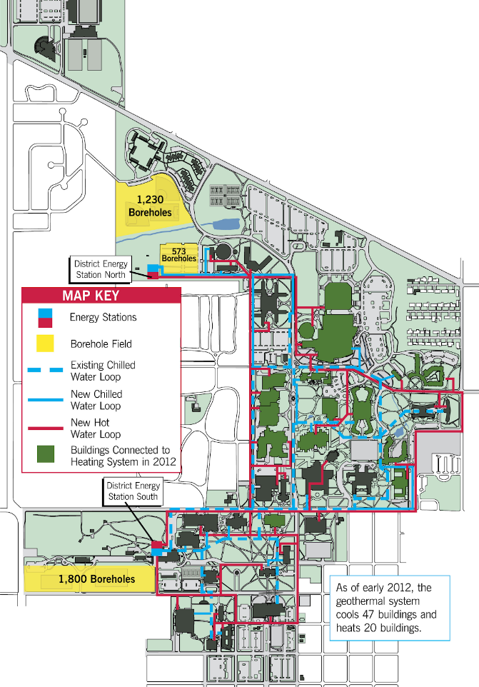


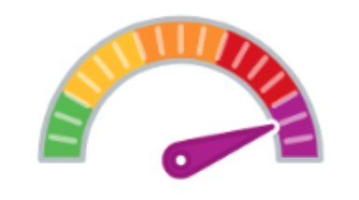





Ground Source Heating and Cooling at Ball State University
A ground source heating and cooling system, also called a “geothermal system” uses the Earth as either a heat source in winter, or a heat sink in summer, because the deep earth at 50⁰ F year round is comparatively warm in winter and cool in summer.
More specifically, ‘geothermal’ heat pumps are used to draw available heat in the winter and sink heat into the ground in the summer. And they are different from the heat pumps used in many homes wherein the heat source is the ambient outdoor air – which in winter can be quite cold and in summer, quite hot. All heat pump types work on the same thermodynamic principle: heat can be pumped from a lower temperature source to a higher temperature source or conversely from higher to lower.
Enormous
Project Timeline
m. 5-10 years
Project Feasibility
A Big Lift
GHG & Environmental Impact
Economic Impact & Savings
Net Savings
Project Maintenance
Publicity Impact
That’s really cool

Slide 3
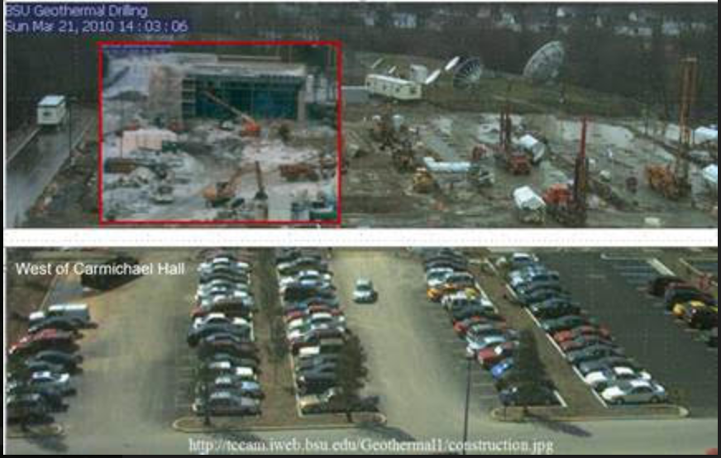
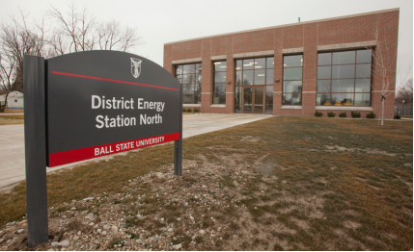
Ground Source Heating and Cooling at Ball State University

Slide 4

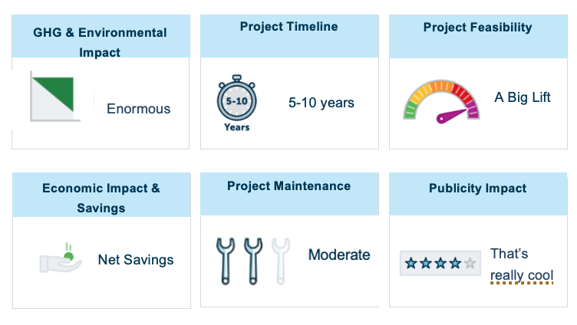
PROJECT
OVERVIEW
The campus-wide application of this geothermal technology, which has a rather long descriptive name (a district-scale, geothermal ground-source heat-pump-chiller system) is composed of four key components: boreholes, energy stations, hot and cold district loops of water-filled pipes, and building interfaces. Read more about each of the various components on the Ball State University website here. The boreholes have been installed at 15’ spacing across two area locations on campus; each of which has been restored to original use and beauty. People using the respective parking lots and recreational fields do not notice they are atop a borehole field. See a map of the locations.
The geothermal project is part of Ball State’s long-standing commitment to sustainability. In a fitting tribute, the geothermal project was dedicated in conjunction with the final in a series of 9 on-campus national conferences; entitled, Greening of the Campus IX: Building Pedagogy. This interdisciplinary conference allowed people representing diverse areas in university communities to share information on environmental issues. Among many related international recognitions, Ball State was the 2010 recipient of Second Nature’s Climate Leadership Award.

Slide 5

PROJECT
IMPACT
GHG & Environmental Impact
Enormous
Economic Impact & Savings
Net Savings
.
Ball State University has been able to reduce the amount of carbon dioxide it adds to the atmosphere by a substantial amount—about 86,000 tons annually. The net result of switching to the geothermal system has allowed Ball State to cut its carbon footprint roughly in half.
Energy consumption has been greatly reduced for each building connected to the campus-wide system because of the exceptional efficiency of this large-scale application. Specifically, the Coefficient of Performance (COP) of the District-scale system is 7.77; meaning that for every kWh of electrical consumption, some 7.77 kWh of impact in heating and cooling results.
Although the project required an investment of some $25 million dollars above the cost of a replacement boiler/chiller system, the annual Return on Investment (ROI) equates to ~8%. Additionally, with the construction of this geothermal project, Ball State has been able to provide an estimated 2,300 direct and indirect jobs. The system will heat and cool 7.2 million square feet of space in 47 buildings and yield $2 million in annual savings by eliminating coal burning and operating more efficiently. This development benefits both the economy and the environment.

Slide 6
PROJECT
IMPACT
Project Feasibility
A Big Lift
Space, underground utilities, and funds can significantly influence feasibility. Ball State’s project serves some 7.2 million square feet of campus buildings, and required sizable acreage for the bore hole fields. Such contiguous campus acreage might not always be available. The project also required 3600 boreholes and 10 miles of distribution pipes with 1000 miles of borehole pipes buried beneath the surface. Any project of this scale is feasible but requires a significant investment of resources. Nonetheless, the ROI can be substantial.
Project Timeline
5-10 years
Designs are site specific, capital intensive, and require many steps before implementation. That explains why Ball State drilled the first bore hole in 2009 and the second energy station, the North Energy Station (labelled in the picture above), began flowing hot and cold water to buildings on campus in January 2015.

Slide 7

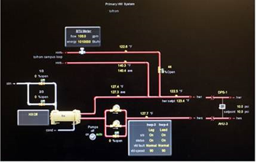
PROJECT
IMPACT
Project Maintenance
Moderate
Few moving parts once installed. However, the boreholes, energy stations, building interfaces, and hot and cold district loops require maintenance that might be influenced by a number of conditions and events. Routine monitoring of system performance using a dashboard monitor (see image) enables the operational staff to flag any real-time operational anomalies and track consistency of impact. The duality of the system enables switching out of pumps and motors if/when maintenance or replacement is required.
Publicity Impact
That’s really cool
Ball State has received a number of awards and recognitions for their sustainability efforts, 13 to be exact. After all, not only is the data impressive, with a 40% reduction in energy use, and a 777% increase in efficiency noted, but Ball State has made the details of this technical project accessible and comprehensible to those interested. Two awards in particular can explain their high rating of 4 stars on the publicity scale: 2012 AASHE STARS Program Gold Rating and the 2012 Excellence in Integration Award. The former places Ball State among the highest-rated institutions tracked by the Association for the Advancement
of Sustainability in Higher Education (AASHE) at that time. The latter, bestowed by the International Sustainable Campus Network (ISCN), named Ball State its first recipient of this award; the award recognizes single projects or broad initiatives that have successfully integrated sustainability into the culture, community, and/or operations of a campus. Projects like these could reach a broader audience outside sustainability professionals in higher education, though, so Ball State hosted two geothermal conferences (GEOCON I and II) to share the story and impact of this project. Additionally, they continue to offer site tours and responses to line inquiries.
Ball State’s Dashboard Monitor

