Slide 1

Solution Center Project Snapshot
These Slides Are Intended for Reuse
These slides are copyrighted using a Creative Commons license to allow and encourage campus stakeholders to use them (with attribution as described below) to advance their own renewable energy efforts. There are one- and five-page versions of the Project Snapshot in order to ease integration of this content into other campus slide decks as needed.
Copyright © 2020 https://creativecommons.org/licenses/by-sa/4.0/
This work is licensed under a Creative Commons Attribution-ShareAlike 4.0 International License by:
Second Nature Inc. https://secondnature.org/solutions-center/
Coho Climate Advisors, LLC https://www.cohoclimate.com/
License Overview
Share — copy and redistribute the material in any medium or format
Adapt — remix, transform, and build upon the material for any purpose, even commercially.
You must give appropriate credit. Adaptations must also use the same license.
Attribution Example
”Michigan State University Solar PPA -- Solution Center Project Snapshot" by Second Nature, Inc. and Coho Climate Advisors, is licensed under CC BY-SA 4.0. See: https://creativecommons.org/use-remix/attribution/

Slide 2
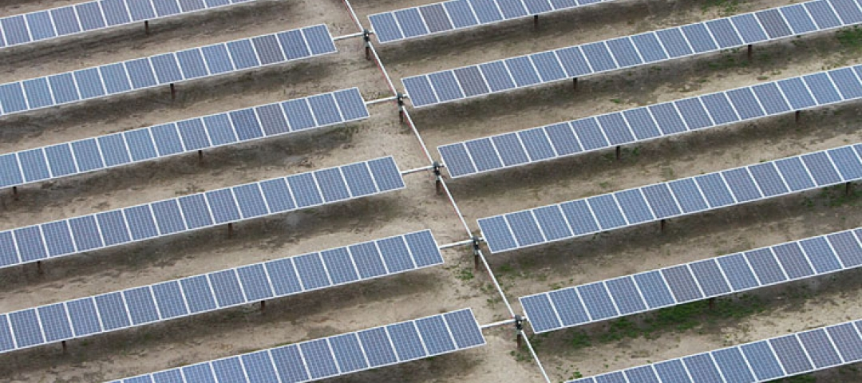

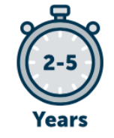



Capital Partners Solar Project at American University and George Washington University
The Capital Partners Solar Project (CPSP) is a 20-year Power Purchase Agreement (PPA) under which Duke Energy Renewables (DER) constructed a 52-megawatt solar photovoltaic (PV) array across three sites in North Carolina and continues to sell the electricity generated to the George Washington University, American University, and the George Washington University Hospital. Commercial operations of the first phase in Pasquotank County near Elizabeth City began in 2015, with second and third sites following in 2016.
Once fully operational, the project was expected to generate about 123 million kilowatt-hours (kWh) of emissions-free electricity in the first year, which averages to about 117 million kWh per year over the life of the agreement due to expected panel degradation over time. This electricity is equivalent to about half the electricity needs of GWU and AU, and about 30% of the electricity needs of GWUH. Since the project did not require any upfront capital from the Universities or Hospital and the electricity is expected to cost less than the open market, the institutions could potentially avoid millions of dollars in possible electric rate increases over the life of the project. The institutions found that this scale provided the best combination of reducing GW’s exposure to the volatility of future market prices while still reaching the scale necessary for the most competitive prices.
GHG & Environmental Impact
Enormous
Eliminate 65k MTCO2e annually
Project Timeline
2-5 years
Project Feasibility
Difficult
Economic Impact & Savings
Large Net Savings
Project Maintenance
Low/None
Publicity Impact
Wow,
amazing project

Slide 3
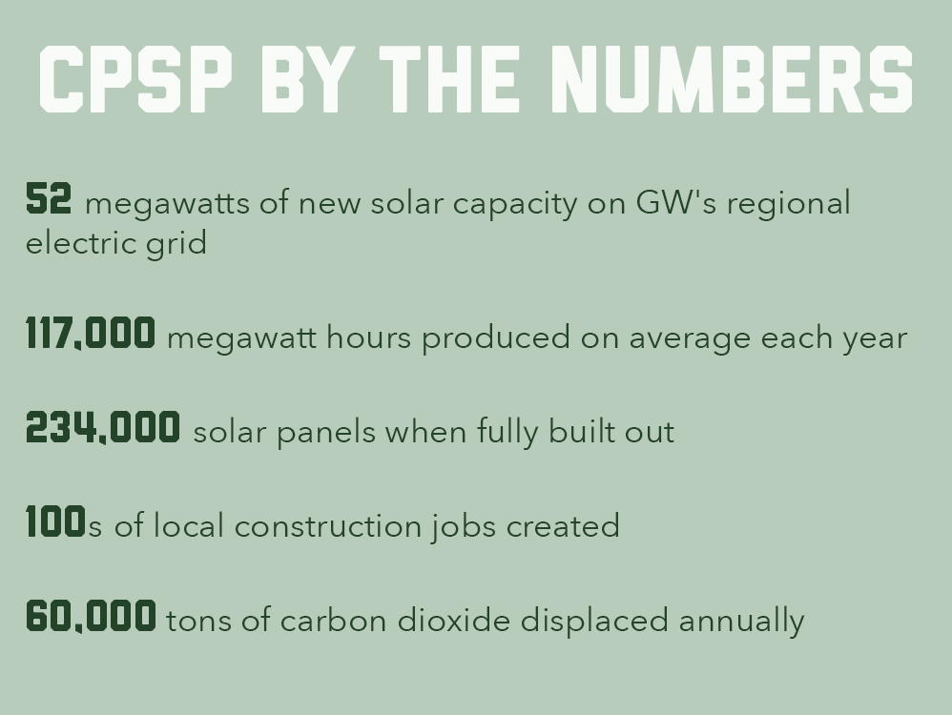
Capital Partners Solar Project at American University and George Washington University

Slide 4
PROJECT
OVERVIEW
Who was involved?
Approximately 60 individuals across the three institutions were involved throughout the two-year planning process including the institutions’ executive leaders as well as their Board of Trustees, representatives from the offices of sustainability, operations, facilities services, investment, planning and administration, procurement, finance, general counsel, and external relations. This ongoing communication and consultation was critical to addressing issues before they could become barriers to the project’s progress.
Outside involvement included many different companies to facilitate and construct the solar array. Coho designed and structured the partnership. Duke Energy Renewables (DER), a commercial subsidiary of Duke Energy, oversaw development, construction, and long-term operation of the sites. SunEnergy1 completed the engineering, procurement, and construction contractor. JinkoSolar manufactured the 92,000 solar panels for the first 20-MW site. Dominion Resources Inc., which owns transmission assets in North Carolina and Virginia, connected the project to the regional grid. PJM Interconnection (PJM) is the grid operator for the Mid-Atlantic region and will oversee transmission of the electricity generated.
.
Why don’t the buyers just put solar panels on their own roofs?
While on-campus solar installations can generate a significant level of emission-free electricity, the sites in North Carolina were chosen because the partners’ dense urban campuses did not have enough rooftop or open space to install the number of solar panels or wind turbines required to meet their ambitious greenhouse gas reduction goals or their approximately 260,000 MWh of combined annual electricity demand. The solar power generated in North Carolina is able to reach the partners about 230 miles away because it is fed onto the same regional electricity grid to which all CPSP partners are connected. Since electrons are fungible, the power purchased from North Carolina can displace electrons on the regional grid that otherwise would need to be produced by more carbon-intensive generation sources, thereby increasing the share of renewable generation in PJM’s regional power supply mix. This fungibility of electrons occurs regardless of generation source, including conventional electricity supply. .
GHG & Environmental Impact
Enormous
Project Timeline
2-5 years
Project Feasibility
Difficult
Economic Impact & Savings
Large Net Savings
Project Maintenance
Low/None
Publicity Impact
Wow,
amazing project!

Slide 5

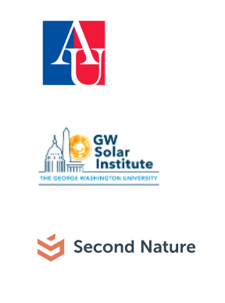
PROJECT
IMPACT
GHG & Environmental Impact
Enormous
The system will utilize nearly a quarter million solar PV panels and, on average, is expected to generate around 117,000 MWh of emission-free electricity per year for GW, AU, and GWUH annually over the 20-year term. The project will displace electricity produced from more polluting sources, reducing GW’s, AU’s, and GWUH’s cumulative emissions by about 60,000 metric tons of carbon dioxide equivalent (CO2e) per year, which is roughly equivalent to removing 12,500 cars off the road; the carbon sequestered by 50,000 acres of U.S. forests annually; or eliminating the emissions from 8,200 U.S. homes’ electricity use.
Under the terms of the contract, the universities and the hospital will receive both the electricity generated by the solar farm and the environmental benefits, also known as Renewable Energy Certificates (RECs), associated with the farm’s production. Most other renewable energy deals include either the electricity or the environmental benefits, but it is less common to receive both. Additionally, the project has been structured so that the customers are purchasing the power at the point of delivery directly from the developer. According to an analysis by Coho, less than one percent of large electricity consumers are able to manage their off-site renewable energy in this way.
Economic Impact & Savings
Although the price of the PPA is confidential under terms of the contract, the 20-year agreement produces a total cost that is competitive with today’s market prices. Cost savings will likely increase over time because market electricity prices are anticipated to rise over the duration of the contract, including a possible future price on carbon. The long-term contract also reduces GW’s exposure to market volatility through a fixed price for a large portion of the electricity consumed.
North Carolina state incentives played a role in the project's location, as North Carolina offered a 35% corporate tax credit for renewable energy investments through 2015. Additionally, the 30% federal investment tax credit also applied and was available in each state through 2016, when it reverted to 10% without further Congressional action.
The project also created hundreds of construction jobs at the solar sites in North Carolina communities, with the majority of jobs being filled by local labor from eastern North Carolina counties.

Slide 6


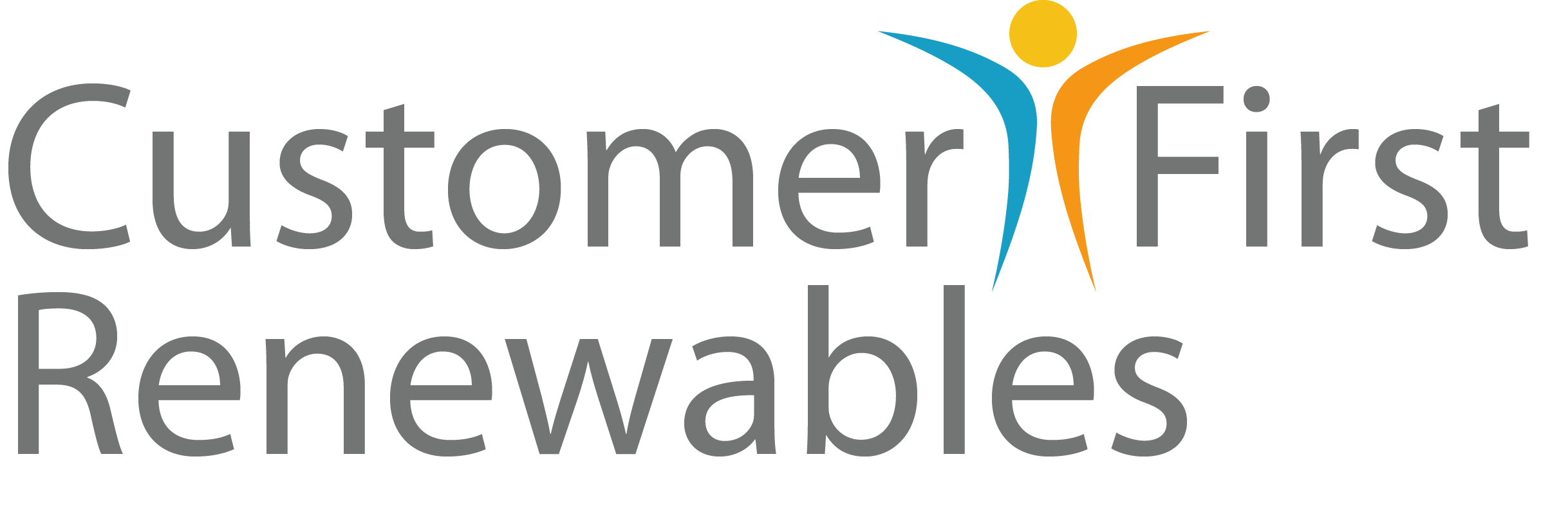
PROJECT
IMPACT
Project Feasibility
Difficult
Project Timeline
2-5 years
The planning process took about two years end-to end. The time from the initial discussion to the signed contract was roughly one and a half years, and six months later commercial operations began. In the future, the process could probably be completed in significantly less time. One of the CPSP goals is to provide information on lessons learned so that other institutions and potential suppliers can pursue similar arrangements more rapidly. In terms of the power purchase agreement, the buyers decided on a 20 year time span because it provided the best balance between getting the most competitive bids and maintaining flexibility in the event that the electricity sector transforms dramatically over the coming decades.
Because these types of deals are relatively new, a great deal of time and effort for education within and across institutions was necessary. For example, issues such as the accounting treatment for this type of contract took time to resolve.

Slide 7

PROJECT
IMPACT
Project Maintenance
Low/None
Buying institutions do not carry any risk related to maintenance operations because maintenance of the facility is the developer’s responsibility.
Publicity Impact
Wow,
amazing project!
When announced, the CPSP was the largest non-utility solar PV PPA in the United States in total megawatt-hours (MWh) contracted.

